Slide 1
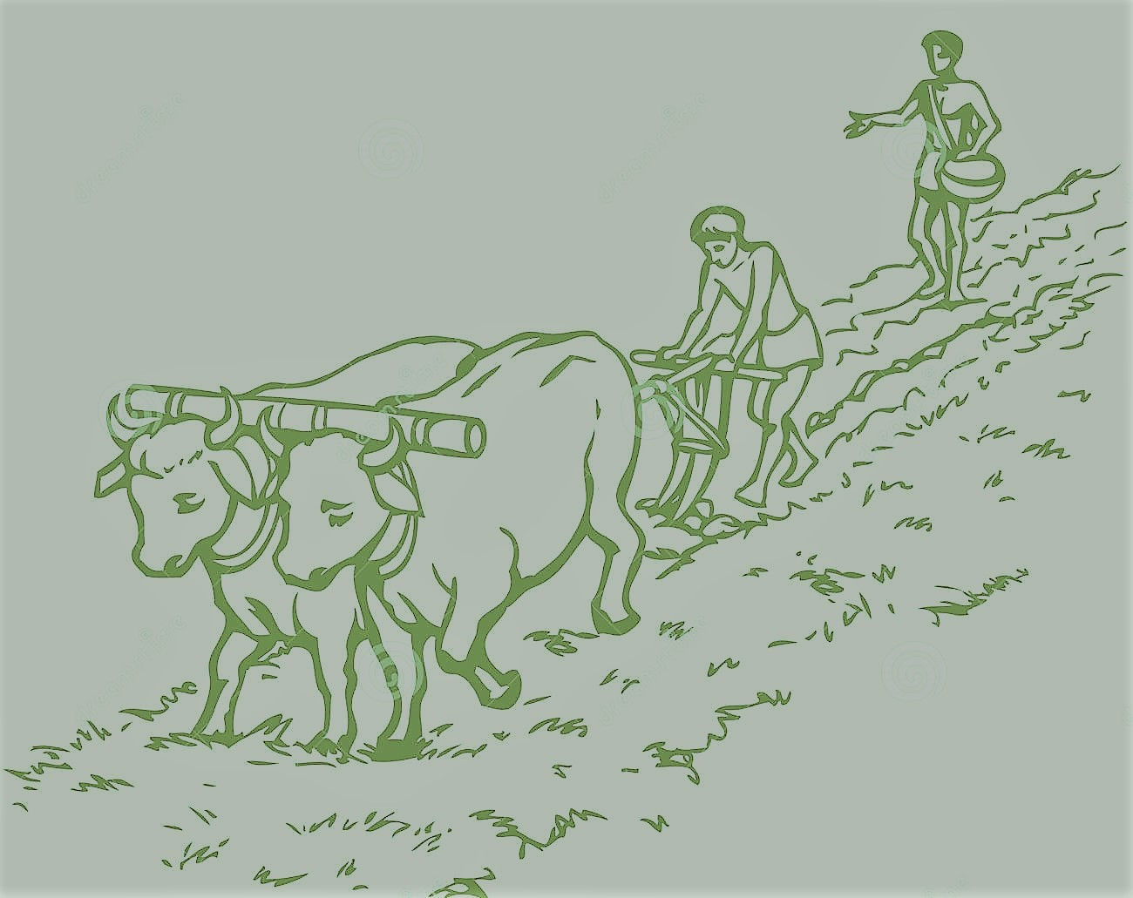
INTELLIGENT FARMING ON WHEELS WITH AI

Slide 2
Problem Statements
Labour increases.
Wastage of water.
Delay in Disease Recognition.
No proper water & pesticides supply.
No proper monitoring.

Slide 3
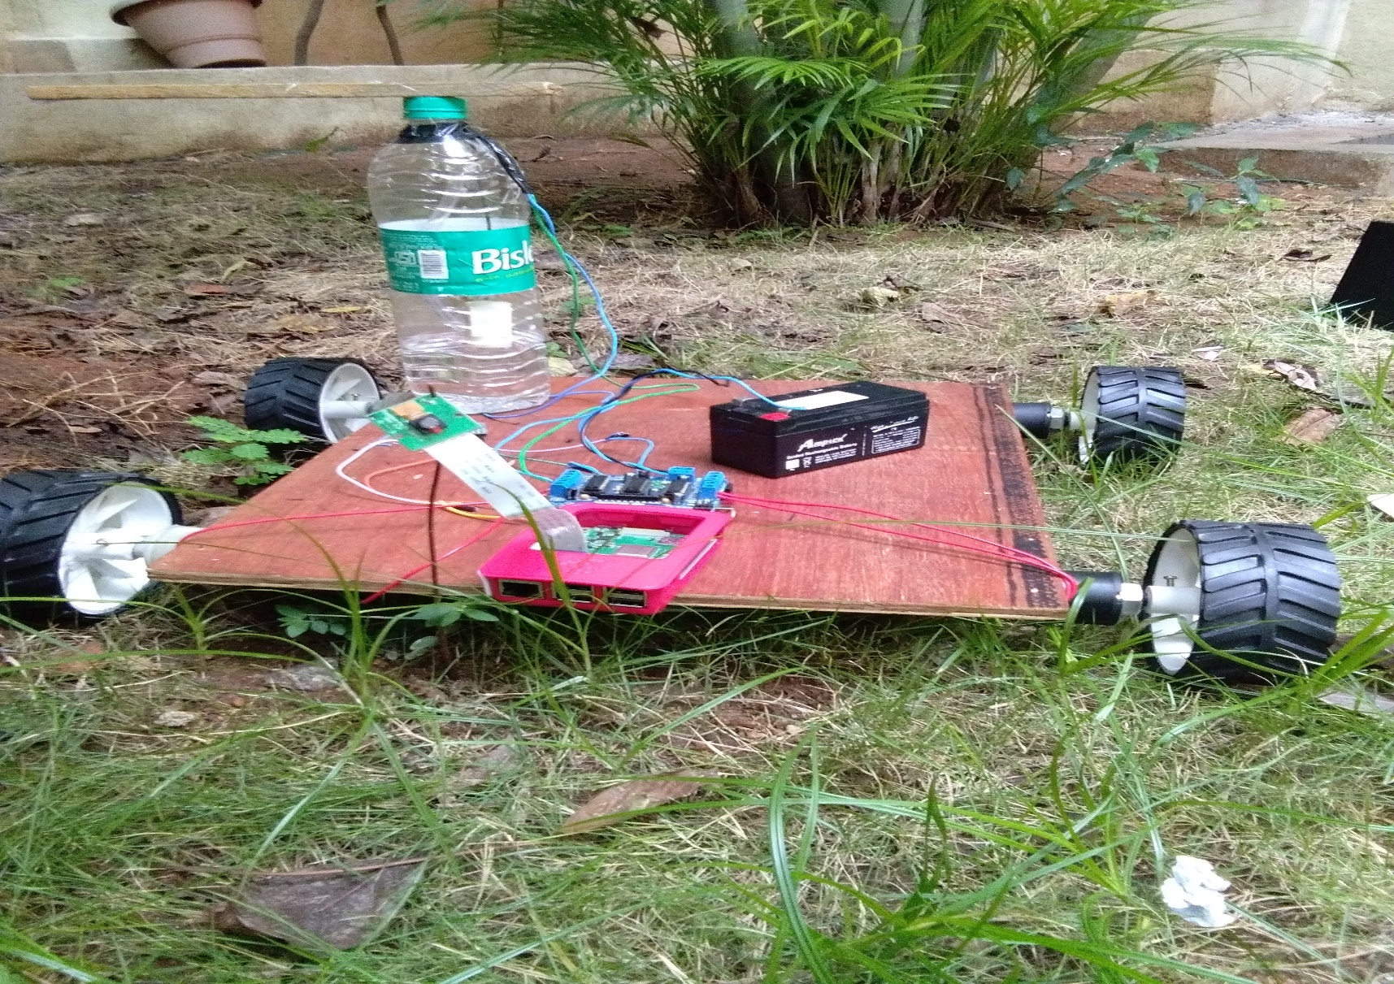
Solution

Slide 4
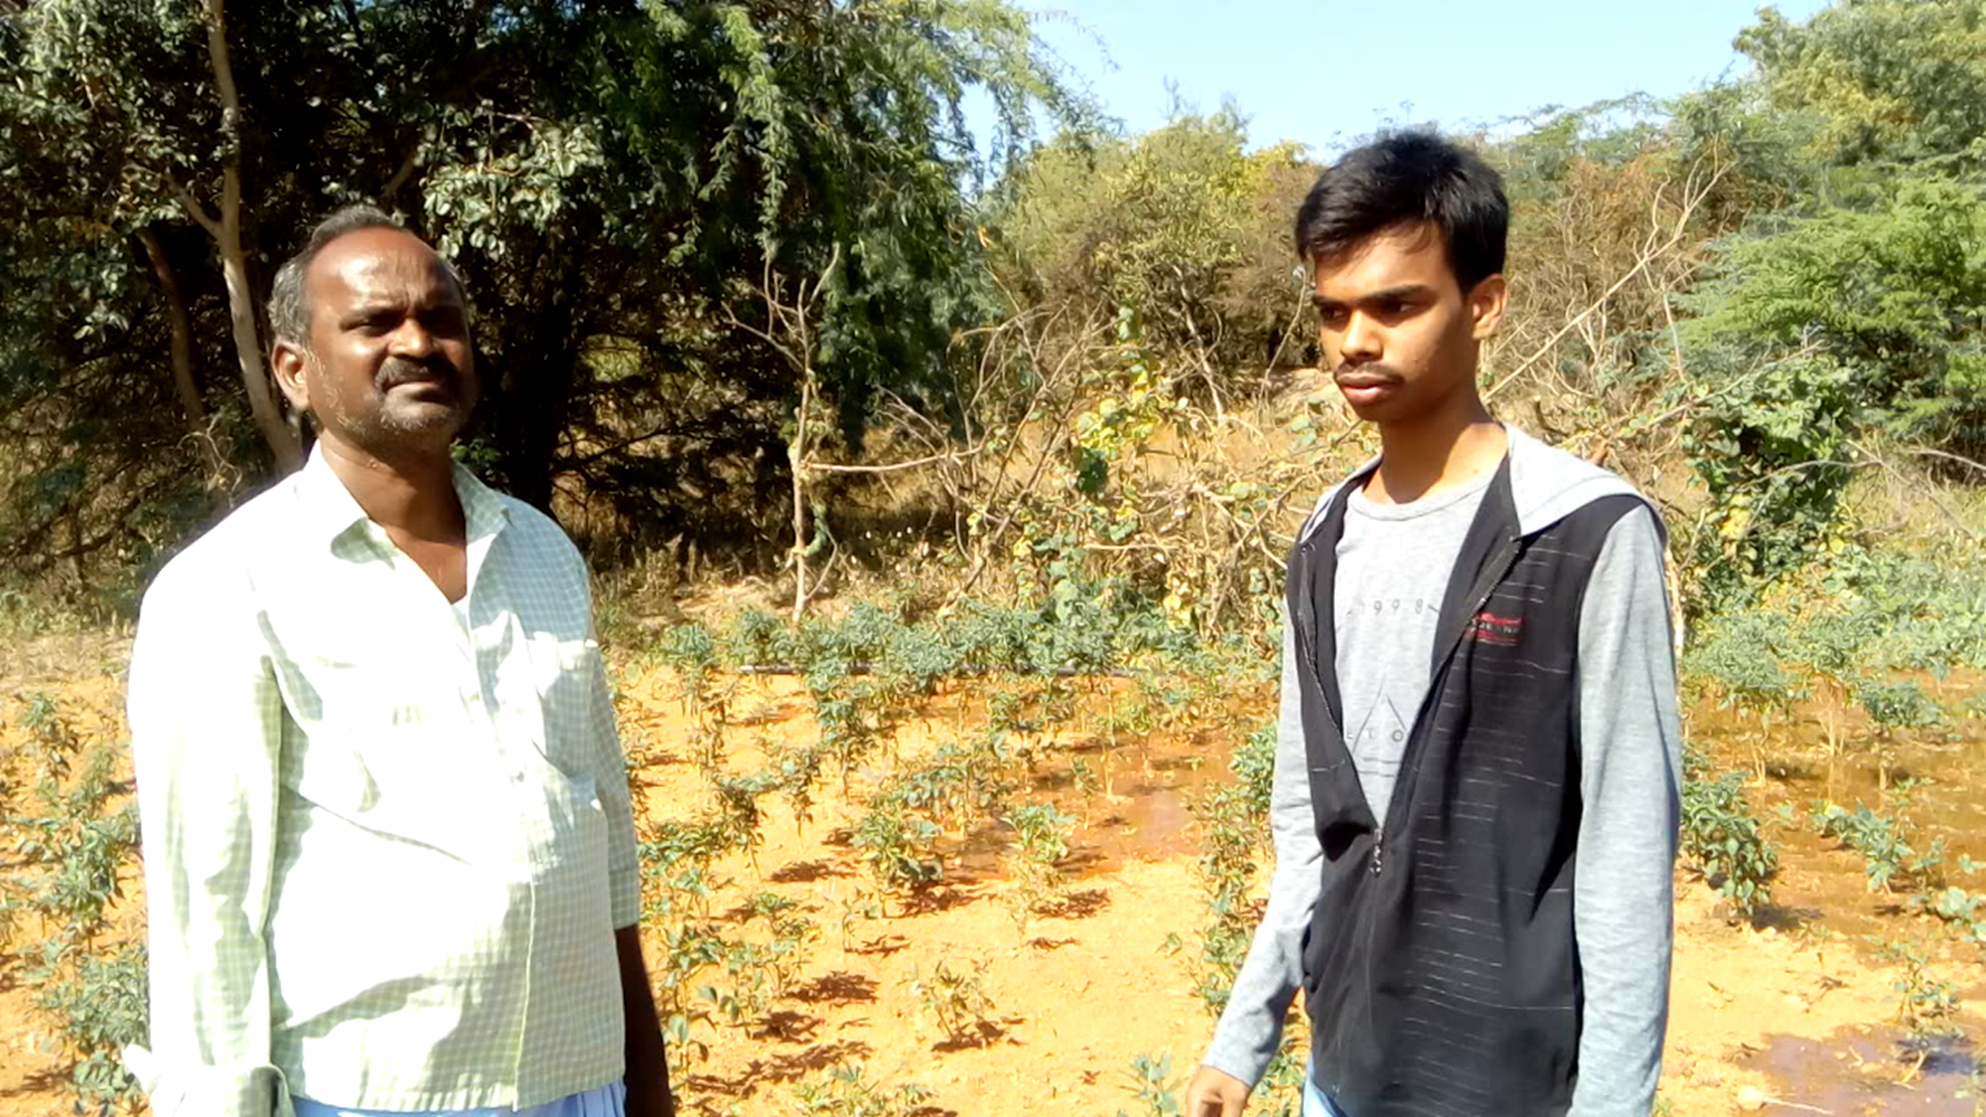
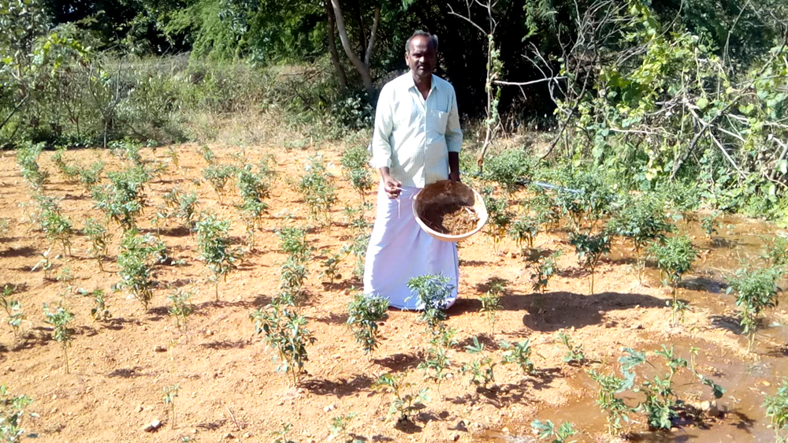
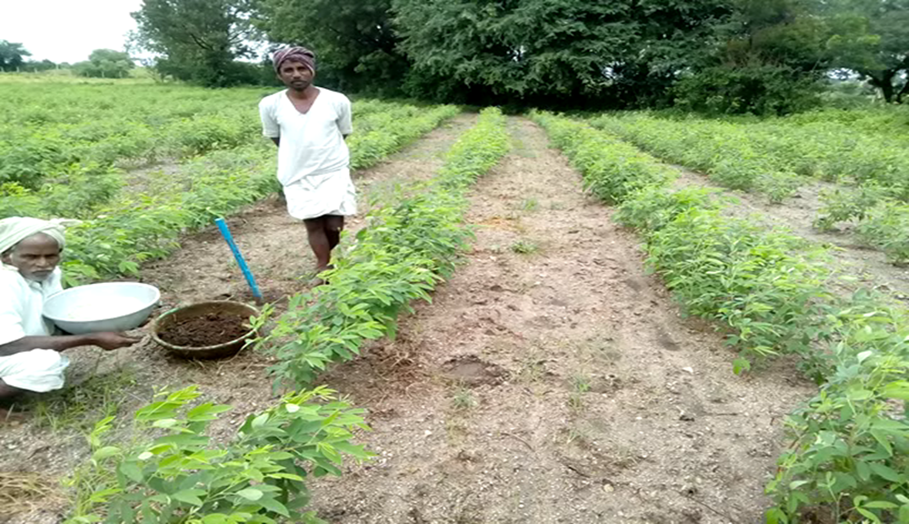
Market Research:

Slide 5
Customers
Farmers
Agriculture Retailers
Consumers
Farmers

Slide 6
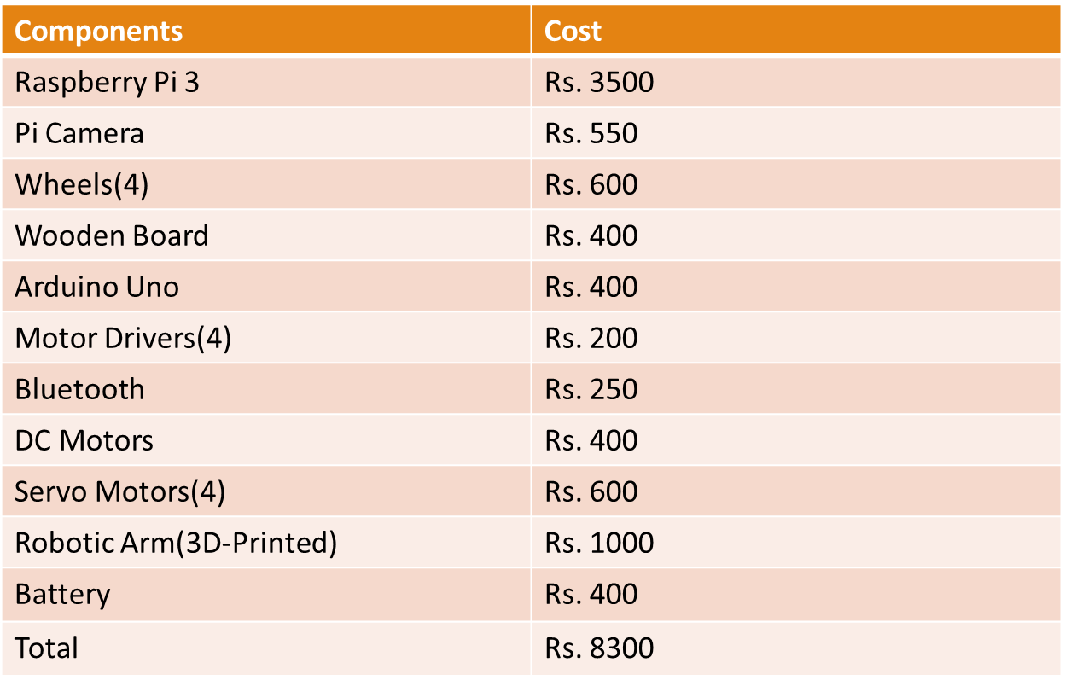
Cost Estimation

Slide 7
Go to Market Strategy
Buisness
Consumer

Slide 8
Team Members:
T. Vinod Kumar Reddy
B. Krishna Kanth
O. Durga Prasad
B. Sailesh
Requirements:
Person who is skilled in Machine Learning.
Contacts with Agriculturists for more Data Sets.

Slide 9
Current Status Of the Product.
The 80% product is done.
We are working to increase the efficiency of our vehicle and accuracy of the diseases in affected plants.
We need more real time data to work effectively.

Slide 10
Thank You
Q&A
Contact Details:
T. Vinod Kumar Reddy
Phone:+91-6304801469
Email id: vinodreddy9739@gmail.com
Github: tecvinodreddy github

